Slide 1
Machine learning
Regent College London
SWE6204

Slide 2
Machine learning
SWE6204

Slide 3

Machine learning
POLYNOMIAL REGRESSION

Slide 4
Learning objectives
Understand concept of Polynomial Regression
Understand the Overfitting
Train-Test Split
Scaling
Examples

Slide 5
Polynomial introduction
When we have a dataset with one predictor variable and one response variable, we often use simple linear regression to quantify the relationship between the two variables.
However, simple linear regression (SLR) assumes that the relationship between the predictor and response variable is linear. But in practice the relationship between the two variables can actually be nonlinear and attempting to use linear regression can result in a poorly fit model.
One way to account for a nonlinear relationship between the predictor and response variable is to use polynomial regression, which takes the form:
Y = β₀ + β₁X + β₂X² + … + β_{h}X^{h} + ε
In this equation, h is referred to as the degree of the polynomial.
Notes:
POSTED ON NOVEMBER 18, 2020 BY ZACH
An Introduction to Polynomial Regression

Slide 6
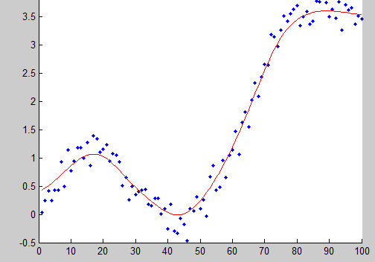
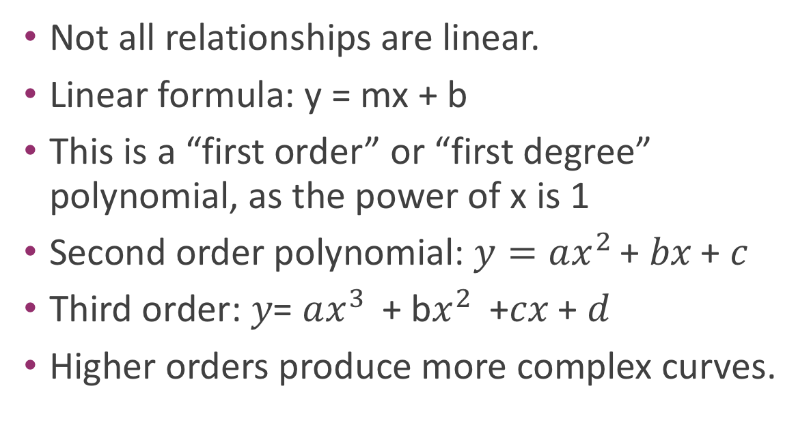
Why limit ourself to straight line
Not all relationships are linear.
Linear formula: y = mx + b
This is a “first order” or “first degree” polynomial, as the power of x is 1
Second order polynomial: $y=ax^{2 }$+ 𝑏𝑥 + 𝑐
Third order: 𝑦= $ax^{3 }$+ b$x^{2 }$ +𝑐𝑥 + 𝑑
Higher orders produce more complex curves.

Slide 7
Polynomial introduction
The model is trained using Polynomial regression and leads to minimum error as well the model accuracy on the training data is 90%.
Then you trained the model using Linear Regression and you observed that it has more errors than what was seen in the Polynomial Regression. So you decide to use the Polynomial regression, but this does not solve the problem. The problem is that when it works on the unseen data, the results are not accurate.
How does it behave in the future when used on different data?

Slide 8
overfitting
In polynomial regression, you can choose different degrees and every degree will give a different curve, also as you increase the degrees, the curve wants to touch all the data that it sees during training and this results in overfitting.
This will lead to less errors on training data , but it will fail on the test data or the future data when the model is used. The models knows the training data does not generalize on the future data.
Poly means many , Nomial means terms or parts
If the 2x+5: It is a simple mathematical equation of two parts:
2x and 5 Or 5 square 2 -2x+5 will be a straight line
Is a polynomial of 3 terms
Ax+b is a linear polynomial

Slide 9
Beware of overfitting
Don’t use more degrees than you need
Visualize your data first to see how complex of a curve there might really be
Visualize the fit – is your curve going out of its way to accommodate outliers?
A high r-squared simply means your curve fits your training data well; but it may not be a good predictor.
Later we’ll talk about more principled ways to detect overfitting (train/test)

Slide 10
Python coding
• numpy.polyfit() makes it easy.

Slide 11
Poly1d
A one-dimensional polynomial class.
The numpy.poly1d() function helps to define a polynomial function. It makes it easy to apply “natural operations” on polynomials.
#NumPy has a method that lets us make a polynomial model:
mymodel = numpy.poly1d(numpy.polyfit(x, y, 3))
myline = numpy.linspace(1, 22, 100)
#start, end and no of points
print(r2_score(y, mymodel(x)))
predictedvalue = mymodel(17)

Slide 12
Advantages of polynomial regression and uses
You can model non-linear relationship between variables.
Tissue growth rate predictions: to consider the non-linear character of the spreading.
Speed regulation software: Allows you to search for patterns in the driver behaviour and inform about the necessity to adhere to the rules even before speed limits are overtaken. Preventive measures have been reported which are effective in decreasing the number of incidents on the roads.
Notes:
Introduction to Polynomial Regression Analysis
Yulia Gavrilova
Article by Yulia Gavrilova
September 21st, 2021
https://serokell.io/blog/polynomial-regression-analysis

Slide 13
Train-Test Split
Train-test split is used to estimate the performance of machine learning algorithms when these are used to make predictions on the data which has not been used to train the model.
It is an evaluation procedure
It is appropriate when there is a large dataset and can be used for classification or regression problems.
scikit-learn machine learning library is used to perform the train-test split procedure
It is not suitable for small datasets as there will not be enough data in the test set to effectively evaluate the model performance.
For small datasets k-fold cross-validation procedure will be efficient.
Notes:
Train-Test Split for Evaluating Machine Learning Algorithms
by Jason Brownlee on July 24, 2020 in Python Machine Learning

Slide 14
Train-Test Split
The dataset is divided into two subsets.
First subset is used to fit the model –Training Dataset
Second dataset is used to pass to the model and predictions are made and compared to the expected values-Test Dataset (Evaluation Dataset)
Training dataset is typically larger than the testing dataset. Once data from our datasets are fed to a machine learning algorithm, it learns patterns from the data and makes decisions.
Test data provides a final, real-world check of an unseen dataset to confirm that the machine learning algorithm was trained effectively.
The difference between training data vs. test data is clear: one trains a model, the other confirms it works (or doesn’t work) correctly with previously unseen data.
Common split percentages include:
Train : 80%, Test 20%
Train : 67%, Test 33%
Train : 50%, Test 50%
Notes:
https://www.obviously.ai/post/the-difference-between-training-data-vs-test-data-in-machine-learning

Slide 15
Syntax of splitting
train,test=train_test_split(dataset,….)
X_train,X_test, y_train,y_test =train_test_split(dataset or X,y,,….test_size=)
When random_state is set and split again, and we should see the same split
X_train, X_test, y_train, y_test = train_test_split(X, y, test_size=0.33, random_state=1)
Notes:
When comparing machine learning algorithms, it is desirable (perhaps required) that they are fit and evaluated on the same subsets of the dataset.

Slide 16
Scaling-standardization
The standardization method uses this formula:
Z(new value) = (x(original value) – u(mean)) / s (standard deviation)
(790 - 1292.23) / 238.74 = -2.1
Python sklearn module has a method called StandardScaler() which returns a Scaler object with methods for transforming data sets.
from sklearn.preprocessing import StandardScaler
scale = StandardScaler()
X = df[['Weight', 'Volume']]
scaledX = scale.fit_transform(X)
Car | Model | Volume | Weight | CO2
Toyota | Aygo | 1.0 | 790 | 99
Mitsubishi | Space Star | 1.2 | 1160 | 95
Skoda | Citigo | 1.0 | 929 | 95

Slide 17
visual
Introduction to Polynomial Regression Analysis (serokell.io)
To watch the video on polynomial regression

Slide 18
summary
In this session, the following concepts were discussed:
Polynomial regression
Advantages and issues like overfitting
Scaling the data and evaluating the model using train-test

Slide 19
reference
Bhandari,M.2020. How to predict Loan Eligibility using Machine Learning Models:Build predictive models to automate the process of targeting the right applicants. [Online].Available at: https://towardsdatascience.com/predict-loan-eligibility-using-machine-learning-models-7a14ef904057
Loong,J.2018. Fitting Polynomial Regressions in Python. [Online].Available at:https://joshualoong.com/2018/10/03/Fitting-Polynomial-Regressions-in-Python/
Mahmood.S.Md. 2021 .Simple Linear and Polynomial Regression. [online].Available at:.https://towardsdatascience.com/simply-linear-and-polynomial-regression-9c9624774f5a
Zach.2020. An Introduction to Polynomial Regression. [Online].Available at:https://www.statology.org/polynomial-regression/
Seher,A.2022.Overfitting Problem In Polynomial Regression . [online].Available at:.https://www.letscodemore.com/blog/overfitting-problem-in-polynomial-regression/
W3schools.2022.Scaling. . [online].Available at:.https://www.w3schools.com/python/python_ml_scale.asp
Sahai,S.2022.How and when to use polynomial regression in ML in python [Online].Available at:https://www.projectpro.io/recipes/and-when-use-polynomial-regression
Brownlee,J.2020.Train-Test Split for Evaluating Machine Learning Algorithms. [Online].Available at:https://machinelearningmastery.com/train-test-split-for-evaluating-machine-learning-algorithms/
Editorial Team.2023.Scaling vs. Normalizing Data.[Online].Available at: https://towardsai.net/p/data-science/scaling-vs-normalizing-data-5c3514887a84

Slide 20
+44 (0)207 016 8000
info@rcl.ac.uk

